Slide 1

Database Management System Lecture 5
Engr. Dr SAIMA WASEEM
School of Systems and Technology (SST)
Artificial Intelligence Faculty

Slide 2
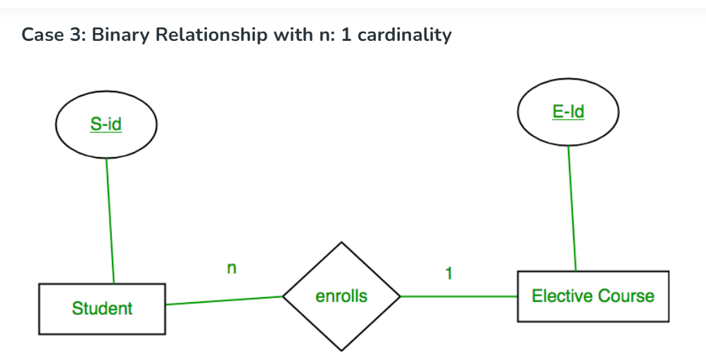
Minimization

Slide 3
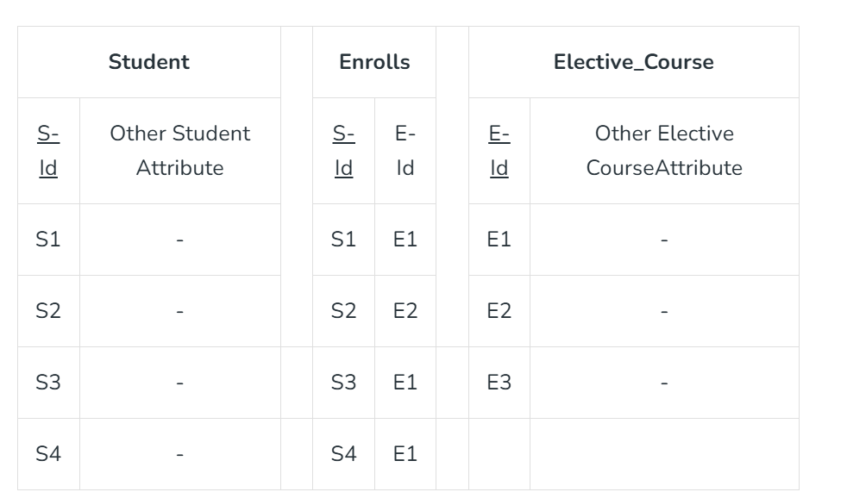
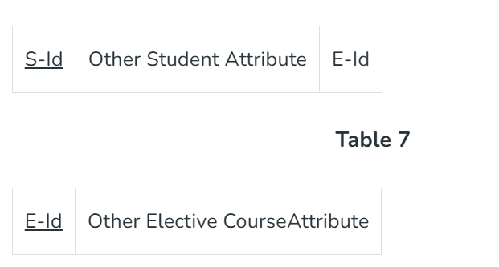

Slide 4
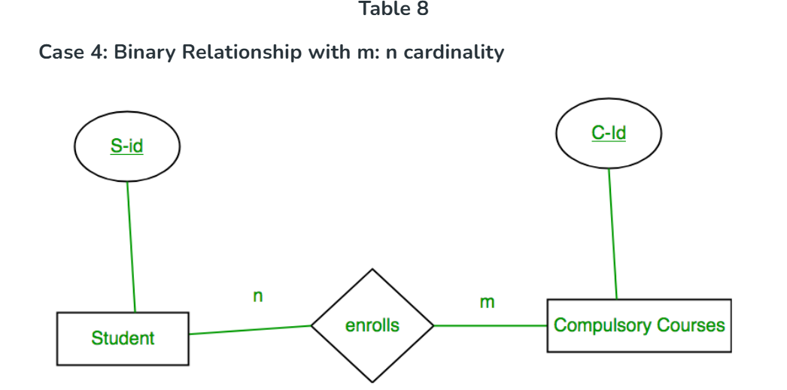

Slide 5
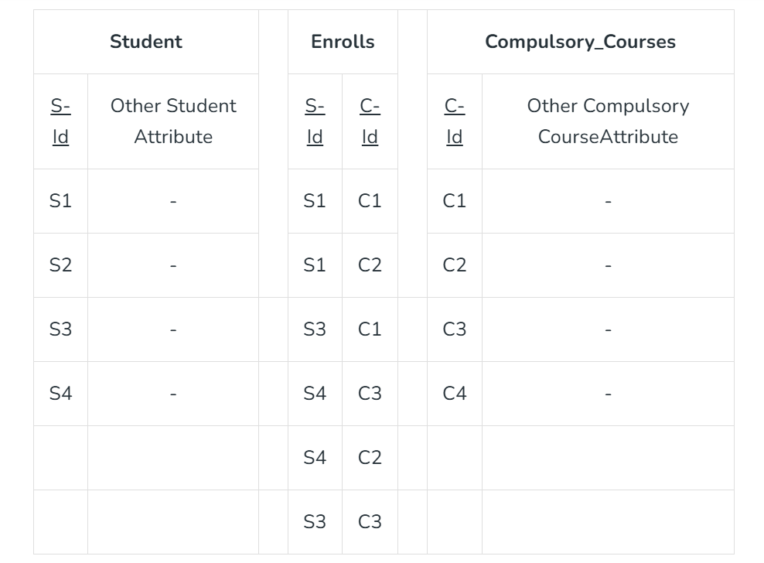
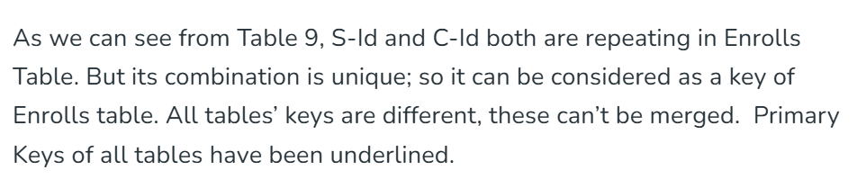

Slide 6
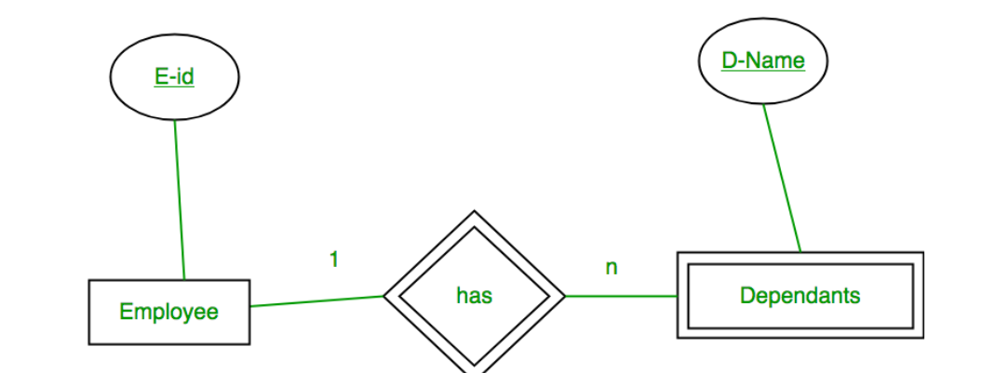

Slide 7
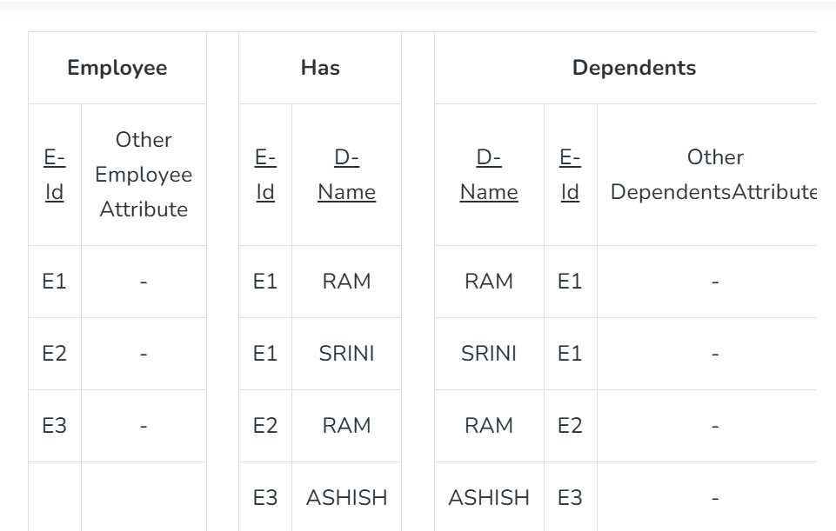

Slide 8
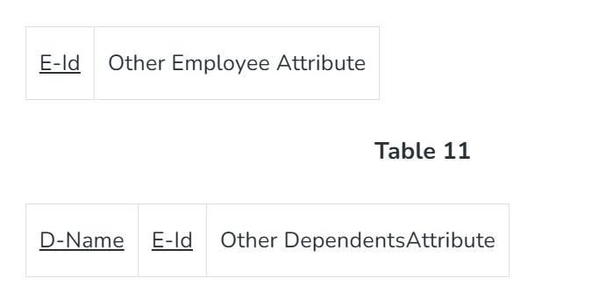

Slide 9
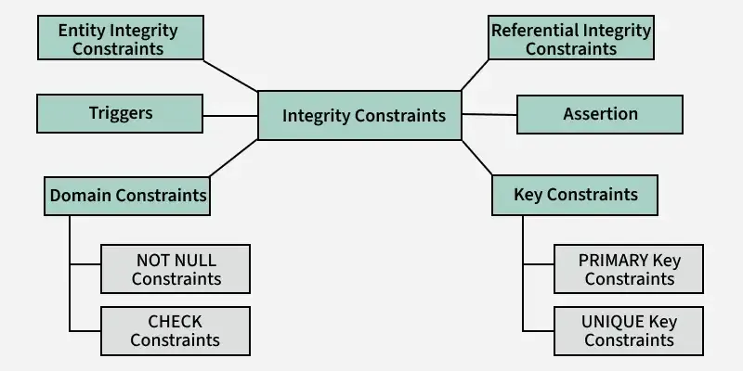
DBMS Integrity Constraints
Integrity constraints in a Database Management System are rules that help keep the data in a database accurate, consistent and reliable. They act like a set of guidelines that ensure all the information stored in the database follows specific standards.

Slide 10
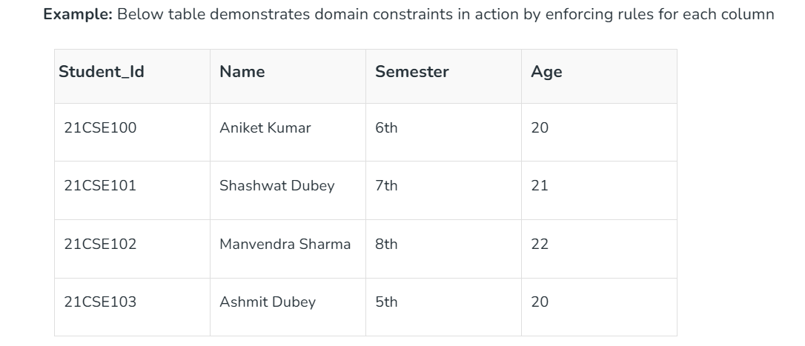
1. Domain Constraints
Domain constraints are a type of integrity constraint that ensure the values stored in a column (or attribute) of a database are valid and within a specific range or domain.

Slide 11
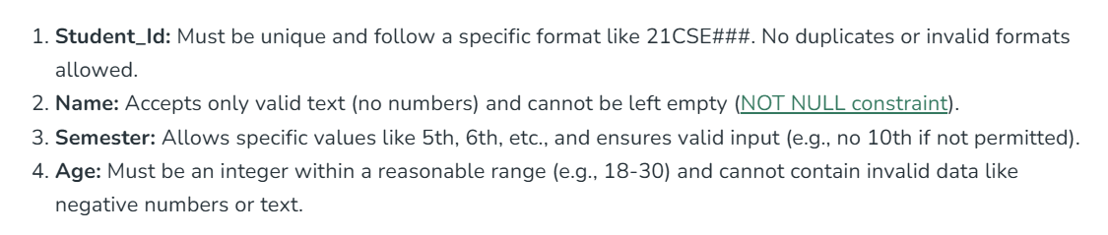
Domain Constraints

Slide 12
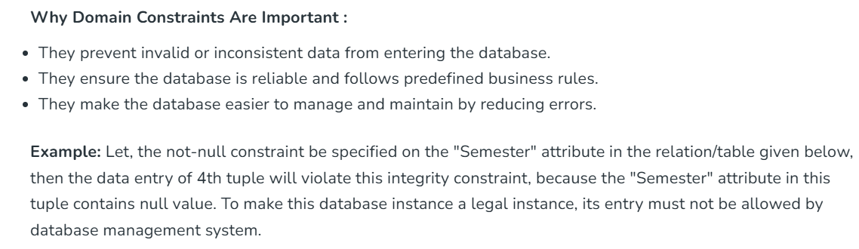
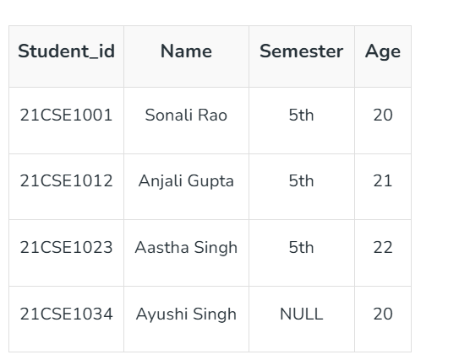

Slide 13

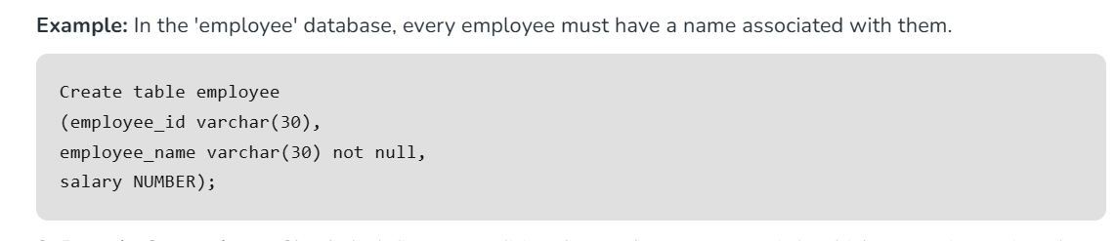
Domain Constraints

Slide 14
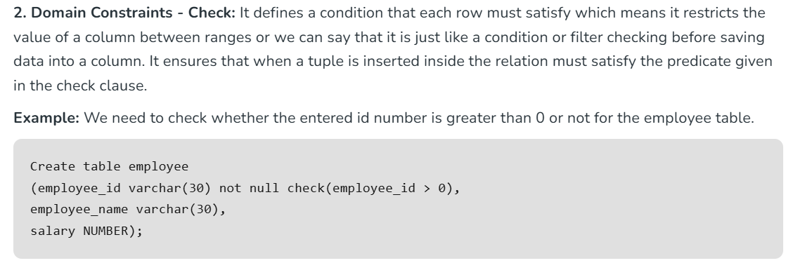
Domain Constraints

Slide 15
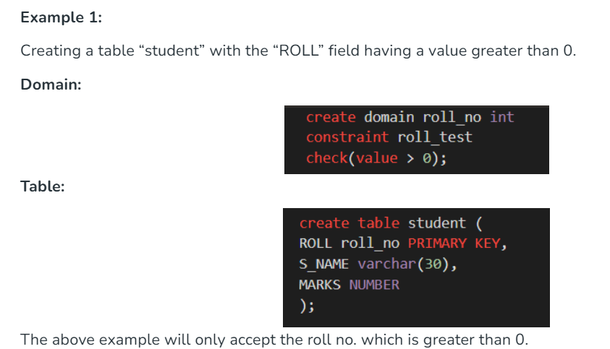
Domain Constraints

Slide 16
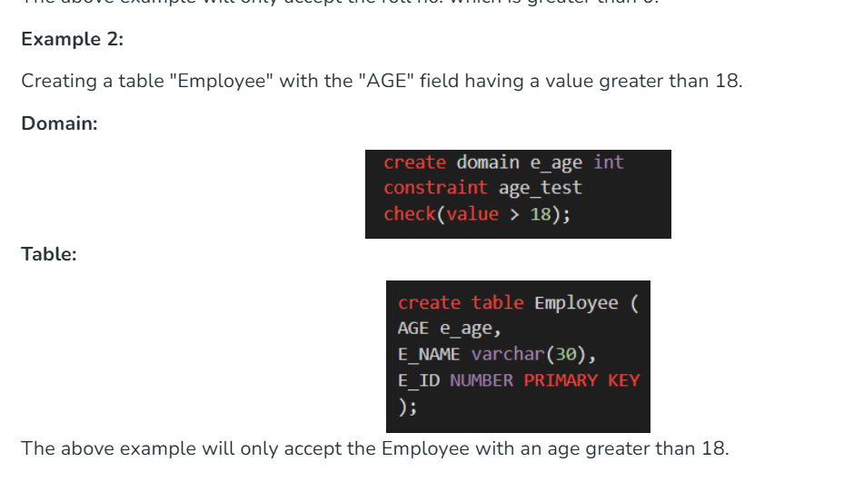
Domain Constraints

Slide 17
2. Entity Integrity Constraints
Entity integrity constraints state that primary key can never contain null value because primary key is used to determine individual rows in a relation uniquely, if primary key contains null value then we cannot identify those rows. A table can contain null value in it except primary key field.

Slide 18
2. Entity Integrity Constraints
Key Features of Entity Integrity Constraints:
Uniqueness: The primary key value must be unique for each row in the table. No duplicate entries are allowed in the primary key column.
NOT NULL: The primary key column cannot contain NULL values, as every row must have a valid identifier.
Essential for Table Design: Ensures that every record in the table can be uniquely identified, preventing ambiguity.

Slide 19
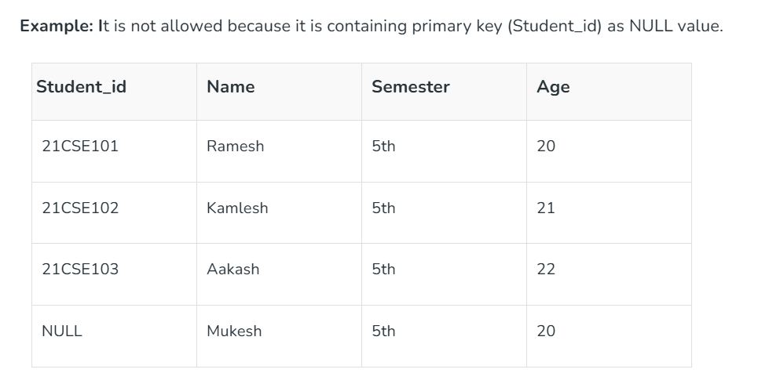
2. Entity Integrity Constraints

Slide 20
3. Key Constraints
Key constraints ensure that certain columns or combinations of columns in a table uniquely identify each row. These rules are essential for maintaining data integrity and preventing duplicate or ambiguous records.
Why Key Constraints Are Important ?
Prevent Duplicates: Ensure unique identification of rows.
Maintain Relationships: Enable proper linking between tables (via foreign keys).
Enforce Data Integrity: Prevent invalid or inconsistent data.

Slide 21
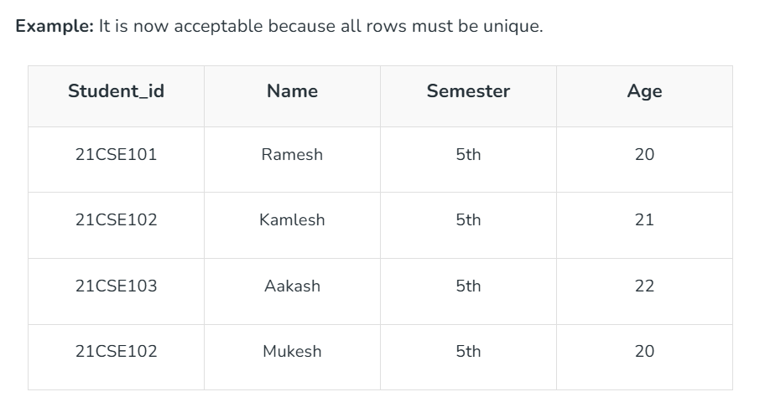
3. Key Constraints

Slide 22
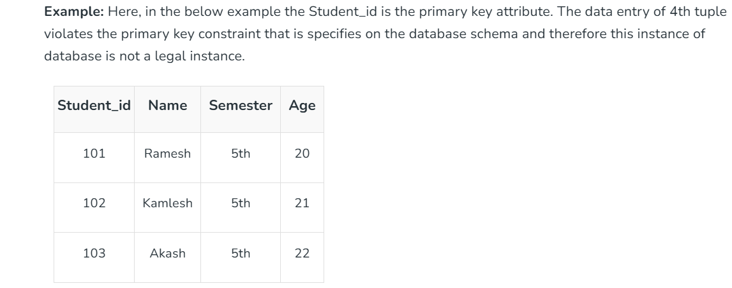
3.1 Primary Key Constraints
It states that the primary key attributes are required to be unique and not null. That is, primary key attributes of a relation must not have null values and primary key attributes of two tuples must never be same. This constraint is specified on database schema to the primary key attributes to ensure that no two tuples are same.

Slide 23
3.1 Primary Key Constraints
Unique Values: Each student_id must be unique. 101, 102, 103 are valid. Inserting 101 again would result in an error.
Not NULL: student_id cannot be NULL.
Invalid: A row with NULL for student_id will be rejected.

Slide 24
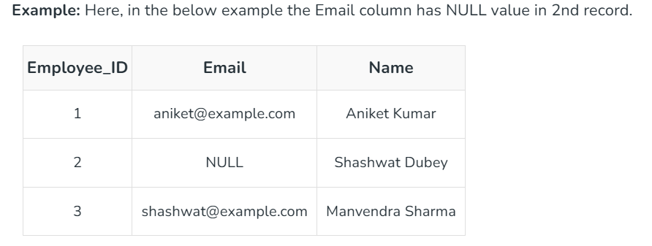
3.2 Unique Key Constraints
The Unique key constraint in DBMS ensures that all values in a specified column (or group of columns) are distinct across the table. It prevents duplicate entries, maintaining data integrity, but unlike the primary key, it allows one NULL value.

Slide 25
4. Referential integrity constraints
Referential integrity constraints are rules that ensure relationships between tables remain consistent. They enforce that a foreign key in one table must either match a value in the referenced primary key of another table or be NULL. This guarantees the logical connection between related tables in a relational database.

Slide 26
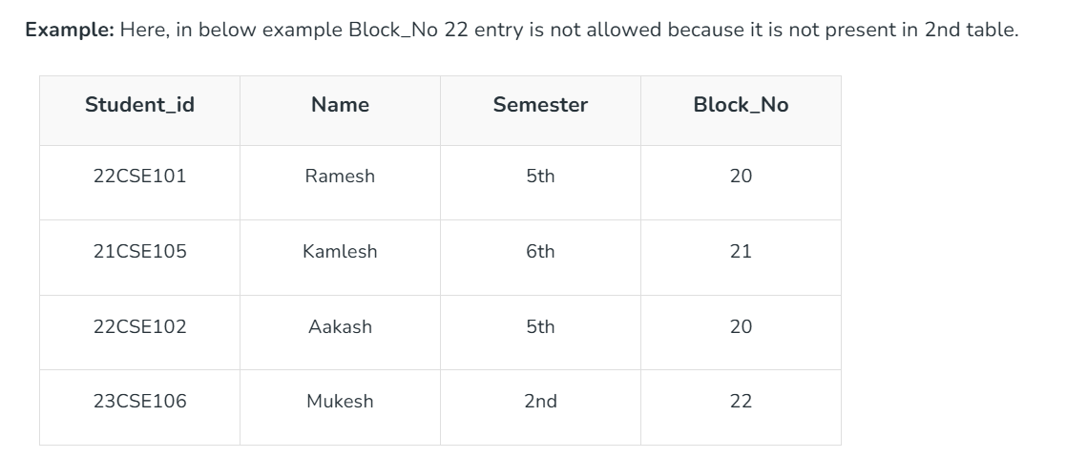
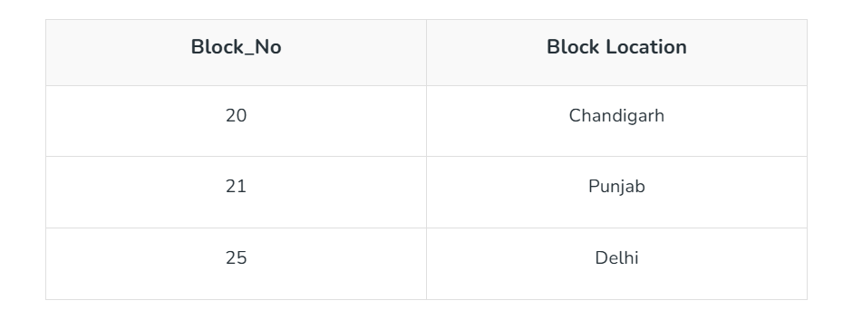

Slide 27
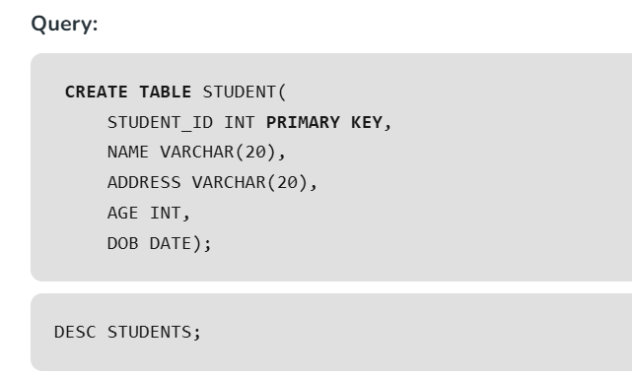

Slide 28
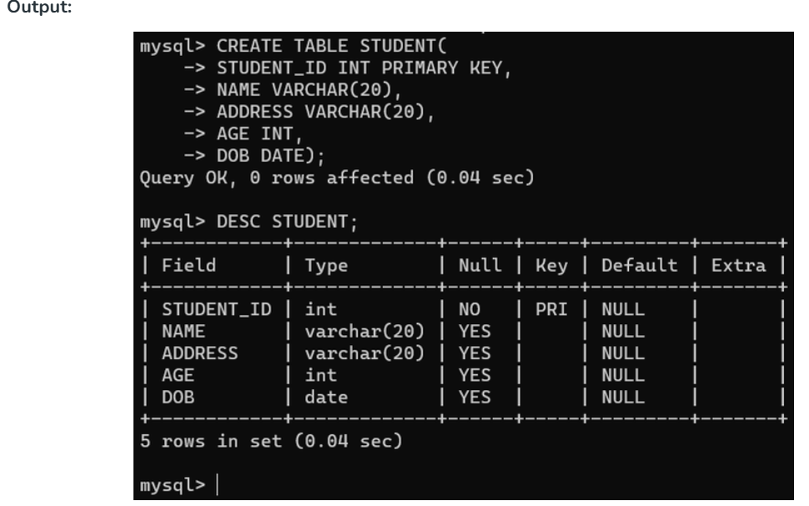

Slide 29

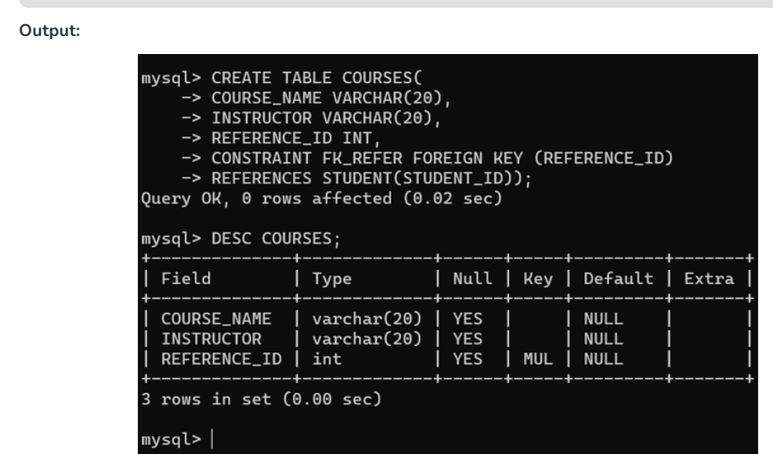

Slide 30
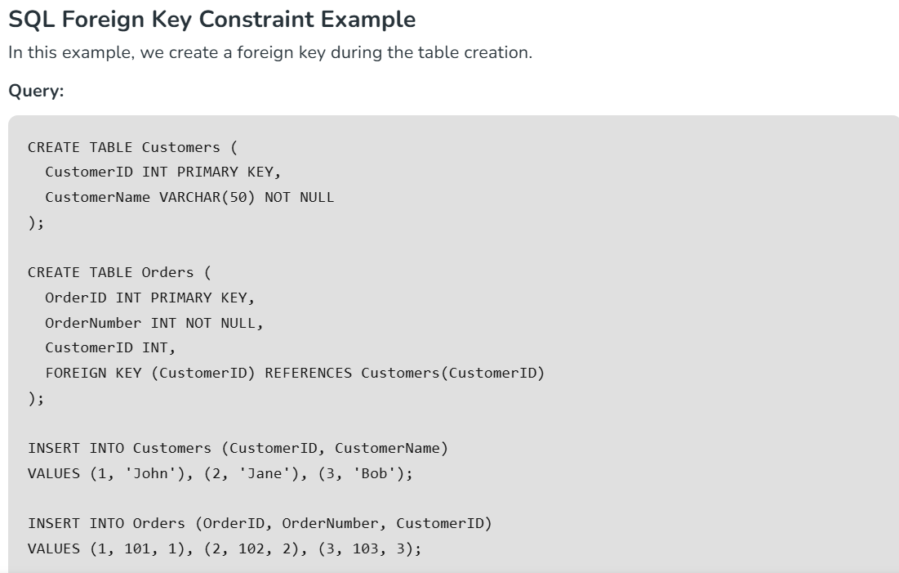

Slide 31
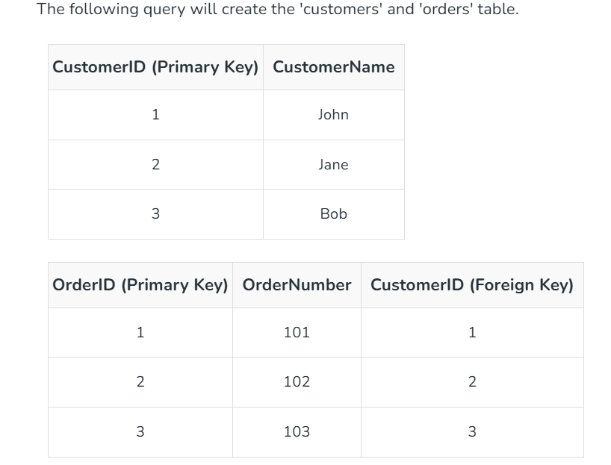

Slide 32
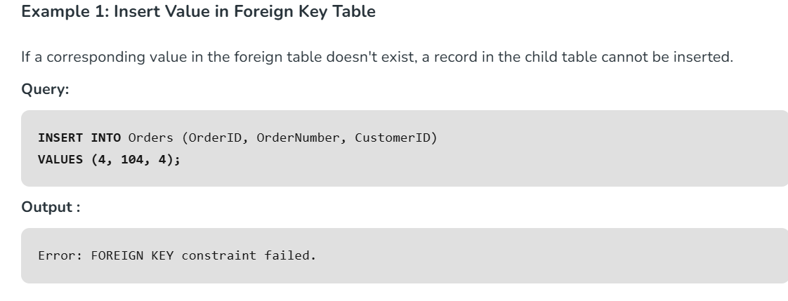

Slide 33
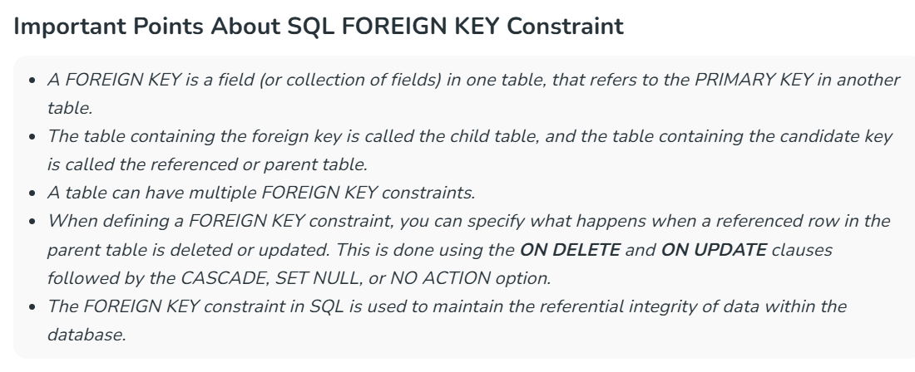

Slide 34
Assertion
An assertion is a declarative mechanism in a database that ensures a specific condition or rule is always satisfied across the entire database. It is a global integrity constraint, meaning it applies to multiple tables or the entire database rather than being limited to a single table or column. An assertion in SQL-92 takes the form:

Slide 35
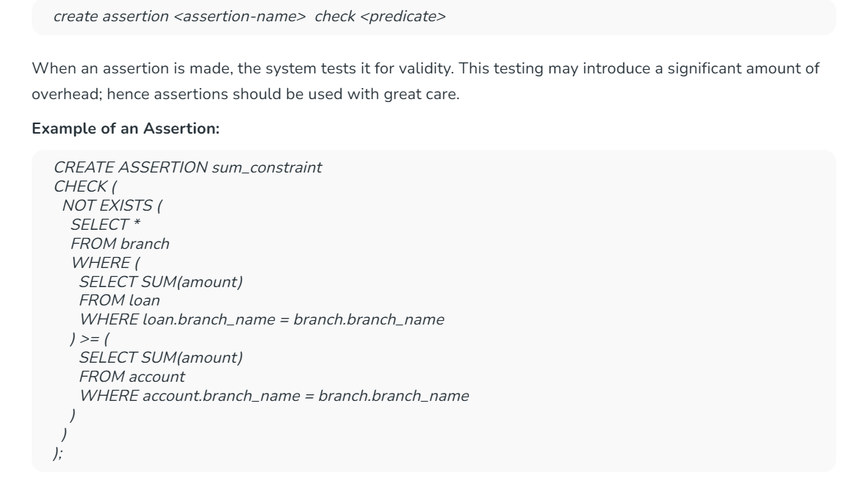

Slide 36
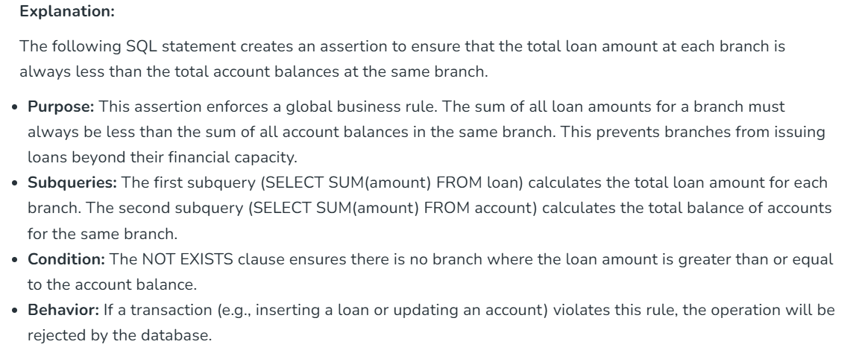

Slide 37
6. Triggers
A trigger is a procedural statement in a database that is automatically executed in response to certain events such as INSERT, UPDATE, or DELETE. Triggers are often used to enforce complex integrity constraints or implement business rules that cannot be captured using standard constraints like primary keys or foreign keys.

Slide 38
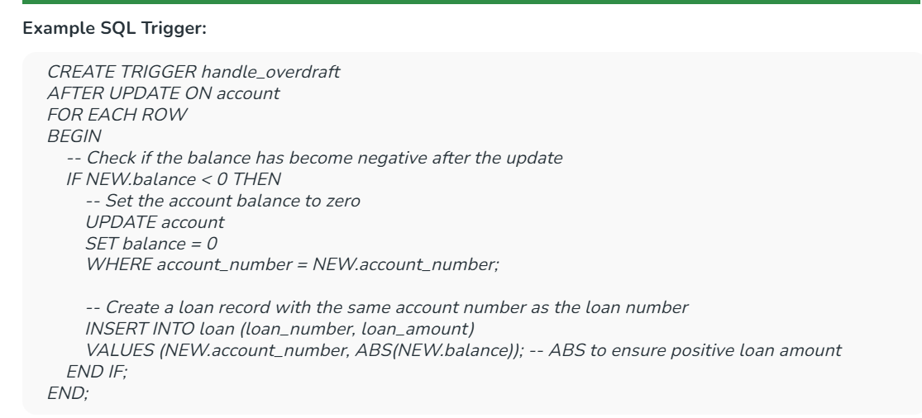

Slide 39
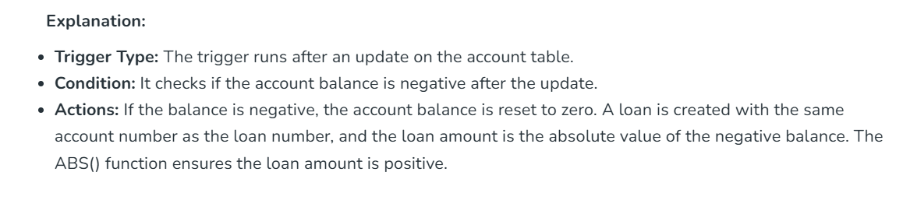
6. Triggers

Slide 40
What is Schema Design?
Schema design is the process of creating a logical and organized structure for a database, which involves defining tables, columns, relationships, constraints and other elements that will govern how data is stored and accessed. Effective schema design is important for creating a robust, scalable and efficient database system.

Slide 41
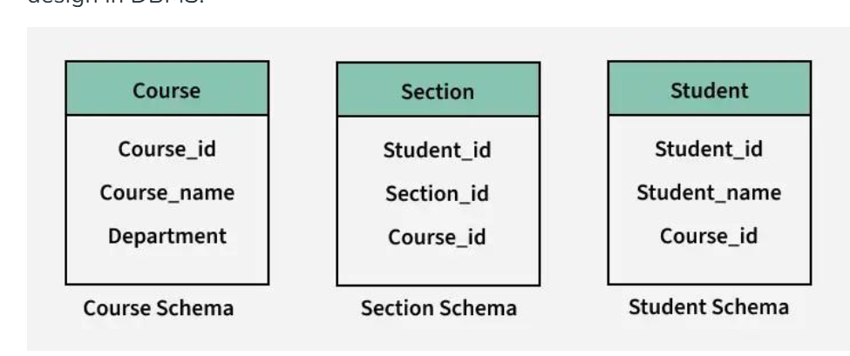

Slide 42
1. Top-Down Strategy
In this strategy, we basically start with a schema that contains a high level of abstraction and then apply successive top-down refinement.
Example: we may specify only a few level entity types and then we specify their attributes and split them into lower-level entity types and relationships. The process of specialization to refine an entity type into a subclass is also an example of this strategy.

Slide 43
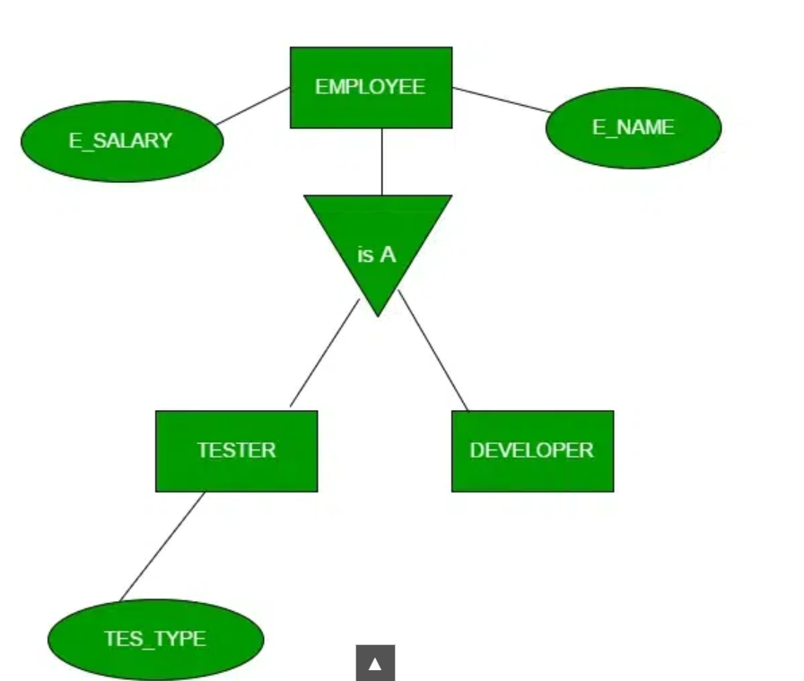

Slide 44
2. Bottom-Up Strategy
In this type of strategy, we basically start with basic abstraction and then go on adding to this abstraction.
Example: we may start with attributes and group these into entity types and relationships. We can also add a new relationship among entity types as the design goes ahead. The basic example is the process of generalizing entity types into the higher-level generalized superclass.

Slide 45
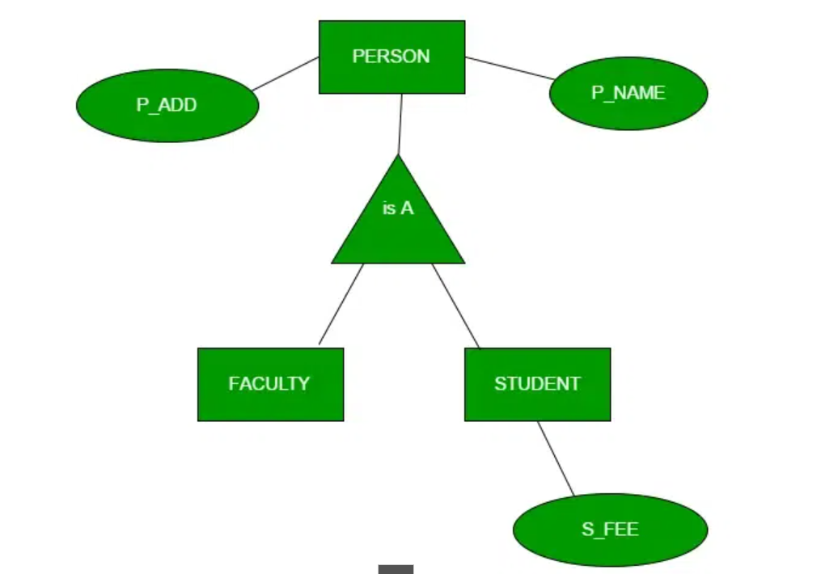

Slide 46
Anomalies in Relational Model
Anomalies in the relational model refer to inconsistencies or errors that can arise when working with relational databases, specifically in the context of data insertion, deletion and modification. Anomalies can compromise data integrity and make database management inefficient.

Slide 47
How Are Anomalies Caused in DBMS?
Anomalies in DBMS are caused by poor management of storing everything in the flat database,
lack of normalization
data redundancy
improper use of primary or foreign keys.
These issues result in inconsistencies during insert, update or delete operations, leading to data integrity problems. The three primary types of anomalies are:

Slide 48
Anomalies
Insertion Anomalies: These anomalies occur when it is not possible to insert data into a database because the required fields are missing or because the data is incomplete. For example, if a database requires that every record has a primary key, but no value is provided for a particular record, it cannot be inserted into the database.

Slide 49
Anomalies
Deletion anomalies: These anomalies occur when deleting a record from a database and can result in the unintentional loss of data. For example, if a database contains information about customers and orders, deleting a customer record may also delete all the orders associated with that customer.

Slide 50
Anomalies
Update anomalies: These anomalies occur when modifying data in a database and can result in inconsistencies or errors. For example, if a database contains information about employees and their salaries, updating an employee's salary in one record but not in all related records could lead to incorrect calculations and reporting.

Slide 51
Anomalies
These anomalies can be removed with the process of Normalization, which generally splits the database which results in reducing the anomalies in the database.

Slide 52
STUD_NO | STUD_NAME | STUD_PHONE | STUD_STATE | STUD-COUNTRY | STUD_AGE
1 | RAM | 9716271721 | Haryana | India | 20
2 | RAM | 9898291281 | Punjab | India | 19
3 | SUJIT | 7898291981 | Rajasthan | India | 18
4 | SURESH | NULL | Punjab | India | 21
STUD_NO | COURSE_NO | COURSE_NAME
1 | C1 | DBMS
2 | C2 | Computer Networks
1 | C2 | Computer Networks

Slide 53
1. Insertion Anomaly
If a tuple is inserted in referencing relation and referencing attribute value
is not present in referenced attribute,
it will not allow insertion in referencing relation.
In simpler words, an insertion anomaly occurs when adding
a new row to a table leads to inconsistencies.
Example: If we try to insert a record into the STUDENT_COURSE table with STUD_NO = 7,
it will not be allowed because there is no corresponding STUD_NO = 7 in the STUDENT table.

Slide 54
2. Deletion and Updation Anomaly:
If a tuple is deleted or updated from referenced relation and the referenced attribute value is used by referencing attribute in referencing relation, it will not allow deleting the tuple from referenced relation.
Example: If we want to update a record from STUDENT_COURSE with STUD_NO =1, We have to update it in both rows of the table. If we try to delete a record from the STUDENT table with STUD_NO = 1, it will not be allowed because there are corresponding records in the STUDENT_COURSE table referencing STUD_NO = 1. To avoid this, the following can be used in query:

Slide 55
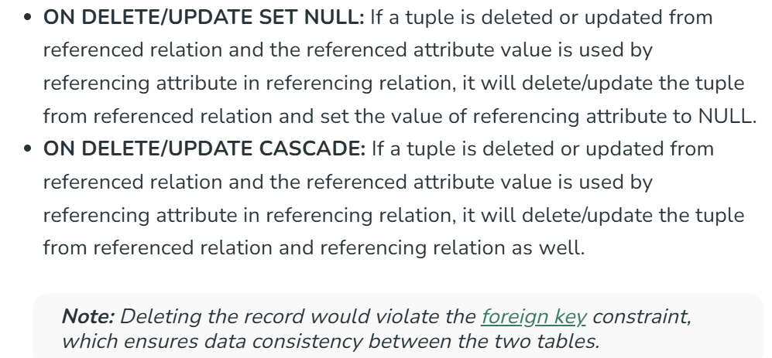
2. Deletion and Updation Anomaly:

